Slide 1

VNS Health
Managed Long Term Care (MLTC)
Provider Orientation
Updated November 2024

Slide 2
Table of Contents
About VNS Health and The Benefits of Partnership
2024 VNS Health Health Plans
Provider Resources
Delegated Vendors
Services Available
Provider Responsibilities
Billing & Claims Processing
Utilization Management
Grievances & Appeals
Compliance Program

Slide 3
About VNS Health and
The Benefits of Partnership

Slide 4

Who is VNS Health?
New York State-based Payer and Provider
Our Non-Profit Mission
As a Quality Champion
130 Years of Experience!
To improve the health and well-being of people through high-quality, cost-effective healthcare in the home and community.
We provide a full range of easy-to-access health plans, home care services, and solutions that are simple to understand and that put our members and patients in control of their health care.
Health Plans
Home Care
Hospice Care
Community Outreach
As Your Partner
Our services touch 49,000
people in New York State
every day.
Care Management
Behavioral Health
We strive to create valuable relationships with providers and other organizations that are meaningful to those we serve, to help maximize the impact of our programs in our communities.
Personal Care
Professional Solutions
* All information reviewed as of 2023.
Notes:
Other Highlights for Your Presentation:
Our Legacy. Your Future.
For more than 125 years, New Yorkers have called us the
Visiting Nurse Service of New York. Through all those years,
we have had nonstop commitment to our neighbors. Like the
communities we serve, we have changed and grown through
the years to meet our neighbors’ needs.

Slide 5

Core Values
Empathy
We seek to understand
others’ feelings and
experiences in order
to actively help.
Our Core Values are at the center of everything we do at VNS Health. They unify all team members around a set of shared principles and behaviors.
Integrity
We do the right
thing even when
no one is looking.
Agility
We use experience
and creativity to
move quickly.

Slide 6
2024 VNS Health
Health Plans

Slide 7

Medicaid Managed Long-Term Care (MLTC)
MLTC Benefits
VNS Health MLTC includes all the Medicaid long-term care and other health-related services members need to live well at home and in community, including:
$0 Monthly plan premium $0 Copays for covered services Care coordination from a dedicated care manager Medication management Home-delivered meals Home safety modifications/improvements Medical equipment and supplies Chore services and housekeeping Personal emergency response systems Adult day health care Social adult day care
Personal Care Home care 24/7 Nurse Support Line Nursing home care Respiratory therapy and oxygen Prosthetics and orthotics Dental care Eye exams and glasses Foot care Hearing exams and hearing aids Medical equipment and supplies Nutritional counseling Telehealth

Slide 8
VNS Health Managed Long Term Care (MLTC) Service Area:
New York State
Our service areas: Albany The Bronx Columbia Delaware Dutchess Erie Fulton Genesee Greene Herkimer Kings (Brooklyn) Madison Monroe Montgomery Nassau New York (Manhattan) Niagara Oneida Onondaga | Orange Orleans Ostego Putman Queens Rensselaer Richmond (Staten Island) Rockland Saratoga Schenectady Schoharie Suffolk Sullivan Ulster Warren Washington Westchester Wyoming Wyoming
Counties covered
Visit our website for additional information: www.vnshealth.org/service-areas
Notes:
This slide is NOT pre-programmed into this PowerPoint file. Programmed slide special features do not apply.
Most elements on this slide are editable, moveable and can be deleted.
Please adhere to brand guidelines and instructions to ensure consistency.
To copy the NY map onto other slides: Click on the NY map section you require > ‘Copy’ and ‘Paste’ onto correct slide.
Can double click into grouping to select a specific region to recolor.
To add a footer: Click in the footer placeholder and start typing. Please make sure your footer text remains within this text box for consistency.
If deleted or missing: right click on thumbnail and ‘reset’ slide to bring text box back.
This slide CANNOT be reset to its original slide format after editing, as with programmed slides.
To return back to the original formatting: Select the original slide from the file download > ‘Copy’ the slide > ‘Paste’ > ‘Use destination theme’.

Slide 9

Ready to Refer to VNS Health MLTC?
It’s Easy!
To refer a patient to the VNS Health Medicaid Managed Long Term Care (MLTC) plan:
Discuss the plan with them
VNS Health MLTC Plan Brochure
Download PDF: English Spanish Chinese Russian Arabic
2. Get their permission for VNS Health to contact them
3. Complete and submit the referral form
4. If you have any questions, please call 1-855-282-4642.
You can also submit a referral via the Provider Portal: Log into your account Left side of screen, click on Patients, then click on Enrollment Referrals Click on Submit Referral, you will be directed to a form Complete and submit
Notes:
Portal Link:
www.vnsny.org/for-healthcare-professionals/physician-web-portal/hchb-provider-link/

Slide 10
SelectHealth
VNS Health
SelectHealth from VNS Health is a specialized Medicaid plan for people living with HIV, individuals of transgender experience, and gender non-conforming or people experiencing homelessness, regardless of HIV status.
SelectHealth covers a wide range of services: Medical and hospital services, dental, and vision care HIV and transgender healthcare specialists in hospitals, physician groups and private practices Medical specialists in other fields including cardiology, dermatology, pulmonary medicine and endocrinology Substance use treatment providers, behavioral health providers, and mental health specialists Culturally competent and gender-affirming services Care coordinators who tailor care and services to each individual member Coverage for dependent children
SelectHealth works with Carelon Behavioral Health (formerly Beacon Health Options) to provide these services.
More information on Home and Community Based Services can be found here.

Slide 11
SelectHealth
VNS Health
Service Area
The following areas are serviced by SelectHealth from VNS Health: The Bronx Kings (Brooklyn) Nassau New York (Manhattan) Queens Westchester
Counties covered
Notes:
This slide is NOT pre-programmed into this PowerPoint file. Programmed slide special features do not apply.
Most elements on this slide are editable, moveable and can be deleted.
Please adhere to brand guidelines and instructions to ensure consistency.
To copy the NY map onto other slides: Click on the NY map section you require > ‘Copy’ and ‘Paste’ onto correct slide.
Can double click into grouping to select a specific region to recolor.
To add a footer: Click in the footer placeholder and start typing. Please make sure your footer text remains within this text box for consistency.
If deleted or missing: right click on thumbnail and ‘reset’ slide to bring text box back.
This slide CANNOT be reset to its original slide format after editing, as with programmed slides.
To return back to the original formatting: Select the original slide from the file download > ‘Copy’ the slide > ‘Paste’ > ‘Use destination theme’.

Slide 12
2024 VNS Health Medicare Advantage Plans
VNS Health EasyCare (HMO)
VNS Health EasyCare Plus (HMO D-SNP)
VNS Health Total (HMO D-SNP)
$0 Monthly plan premium (Part C), Primary care copay $35 Specialist copay Prescription drug coverage (Part D) Over-the-Counter (OTC) Card Dental, vision, hearing Acupuncture Routine podiatry Transportation Gym membership Telehealth 24/7 Nurse Hotline Home delivered meals after a hospital stay Up to three inpatient hospital visits/year
$0 Monthly plan premium (Part C), Primary care copay, Specialist copay Prescription drug coverage (Part D) Over-the-Counter (OTC) and Grocery Card Flex Card $350/year to help pay for certain utilities and dental, hearing, and vision expenses. Dental, vision, hearing Acupuncture Routine podiatry Transportation Gym membership Telehealth 24/7 Nurse Hotline Home delivered meals after a hospital stay Up to three inpatient hospital visits/year
$0 Monthly plan premium (Part C), Primary care copay, Specialist copay and Prescription drug coverage (Part D) Over-the-Counter (OTC) and Grocery Card Flex Card $760/year to help pay for certain utilities and dental, hearing, and vision expenses. Dental, hearing, vision Acupuncture Gym membership Telehealth 24/7 Nurse Hotline Long-Term services and supports Worldwide coverage Home delivered meals after a hospital stay Up to three inpatient hospital visits/year

Slide 13
VNS Health Medicare Service Area:
New York State
The following areas are serviced by VNS Health Medicare which includes EasyCare (HMO), EasyCare Plus (HMO D-SNP) and Total (HMO D-SNP). Albany The Bronx Kings (Brooklyn) Nassau County New York (Manhattan) Queens Rensselaer Richmond (Staten Island) Schenectady Suffolk County Westchester County
Counties covered
Visit our website for additional information: www.vnshealth.org/service-areas
Notes:
This slide is NOT pre-programmed into this PowerPoint file. Programmed slide special features do not apply.
Most elements on this slide are editable, moveable and can be deleted.
Please adhere to brand guidelines and instructions to ensure consistency.
To copy the NY map onto other slides: Click on the NY map section you require > ‘Copy’ and ‘Paste’ onto correct slide.
Can double click into grouping to select a specific region to recolor.
To add a footer: Click in the footer placeholder and start typing. Please make sure your footer text remains within this text box for consistency.
If deleted or missing: right click on thumbnail and ‘reset’ slide to bring text box back.
This slide CANNOT be reset to its original slide format after editing, as with programmed slides.
To return back to the original formatting: Select the original slide from the file download > ‘Copy’ the slide > ‘Paste’ > ‘Use destination theme’.

Slide 14
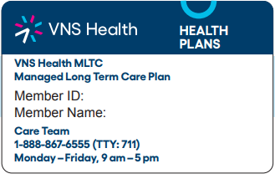
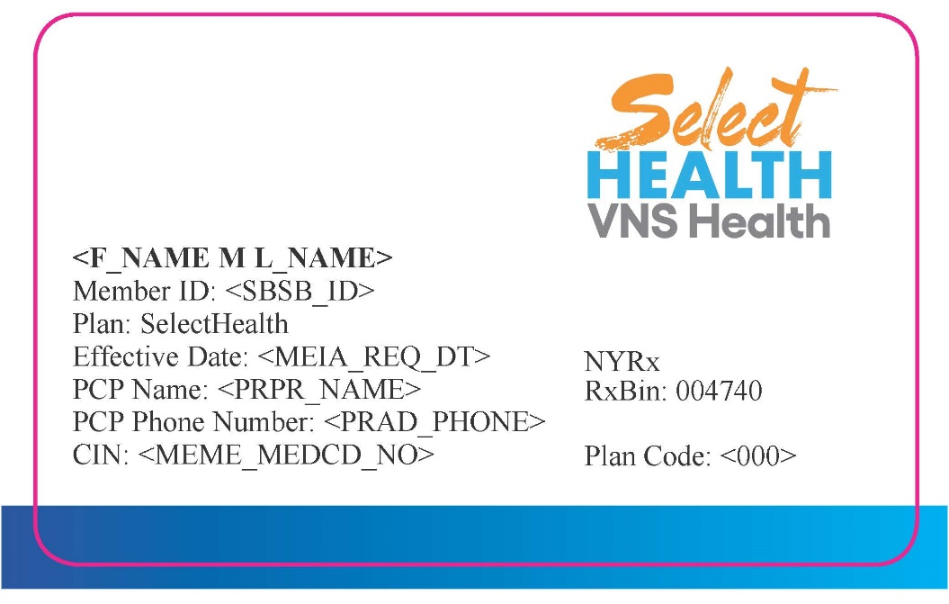
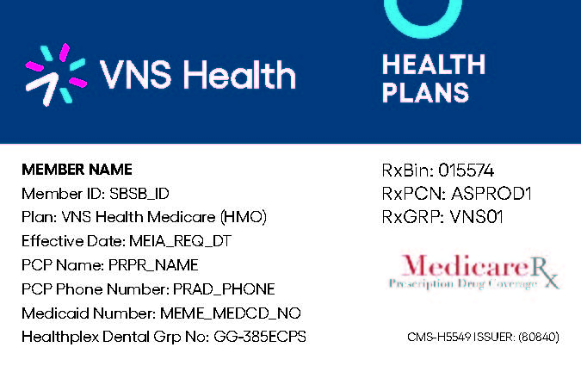
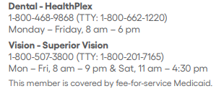
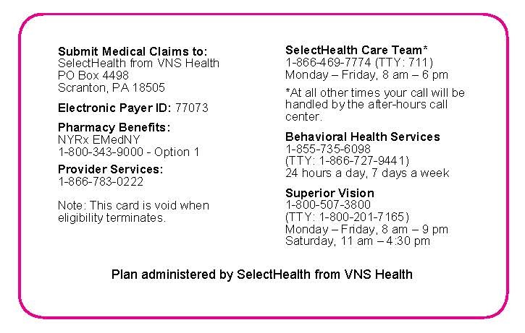
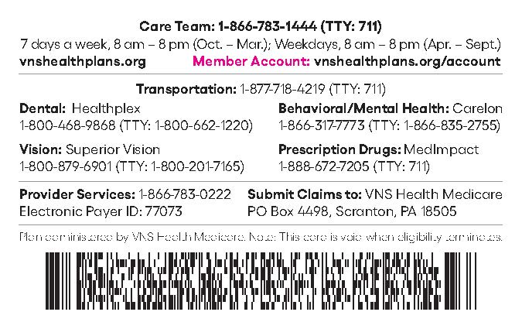
VNS Health Member Sample ID Cards
MLTC Sample ID Card:
SelectHealth from VNS Health Sample ID Card:
EasyCare, EasyCare Plus and Total (MAP) Sample ID Card:

Slide 15
Provider Resources
© Copyright 2024 VNS Health. All rights reserved.

Slide 16

Provider Reference Guide
Quick Reference Guide Content: Member and provider contact centers claims process Online resources Electronic Funds Transfer (EFT) Reinstatement of services Service authorization requests and changes Member referrals and inquiries Ancillary vendors

Slide 17

Website: vnshealthplans.org
Providers have access to a variety of easy-to-use reference materials Provider portal Provider toolkit Claims, billing, and payments Credentialing Notices, news, and updates Formulary search All provider forms Provider manual Quick reference guide Helpful links

Slide 18

Provider Portal
Your one-stop shop for: Patient Membership roster and PCP panel Eligibility search Enrollment referrals Admission, discharge, and transfer (ADT) alerts Claims Authorizations Provider Directory Formulary Search Provider Toolkit Appeals and Disputes Communications Center Resources My Account

Slide 19
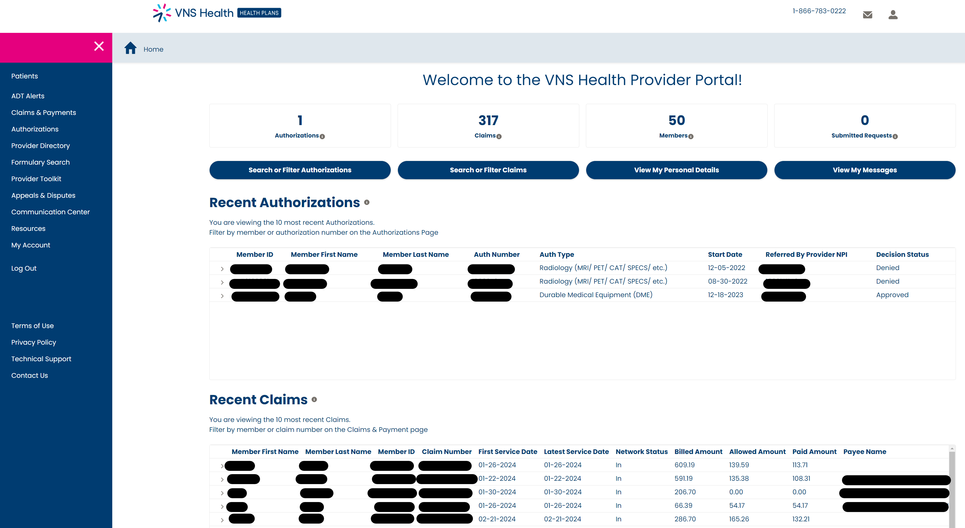
Provider Portal View - Dashboard

Slide 20

Helpful Links and Contacts
Join Our Provider Network Provider Demographic Update Form Provider Credentialing Request Form EFT Request Form Availity Provider Claims Dispute Form Filing an Appeal Phone: 1-866-867-6555 Fax: 1-866-791-2213 Mail: P.O. Box 445 Elmsford, NY 10523 Attn: VNS Health Grievance & Appeals

Slide 21
Delegated Vendors
© Copyright 2024 VNS Health. All rights reserved.

Slide 22

Transportation
As of March 1, 2024, VNS Health Total (HMO D-SNP) and VNS Health MLTC no longer cover non-emergency transportation as part of the benefits. Non-emergency medical transportation is now through the Statewide Transportation Broker, Medical Answering Services (MAS): Online: https://www.medanswering.com/ Call: Monday–Friday 7am to 6pm New York City, Long Island, Westchester, and Putnam counties 1-844-666-6270 Upstate – 1-866-932-7740 For more information, visit the New York State Department of Health Transportation page

Slide 23

DME Supplies - Delivered or Shipped
RX requirements: All items require a prescription, except incontinence supplies within the first 30 days of enrollment Date Member’s name Diagnosis and related ICD 10 code Doctor’s NPI DME product(s) brand Quantity/frequency/size MD signature and date If primary insurance: Medicaid ID and/or VNS ID #
Processes: Fax prescription to VNS Health MLTC 1-212-897-9448 Standard request takes 14 to 28 days (expedited 72 hours) Delays may occur if RX is missing or incomplete Some items may require medical records or chart notes
Supplies distributed by DME vendors:
Surgical, ostomy, tracheotomy supplies
Incontinence
Blood glucose monitors
Canes and crutches
Continuous passive motion devices
Diabetic shoes/insert custom
Heat and cold applications
Manual wheelchair
Orthotics
Breast and limb prostheses
Neuromuscular Electrical Stimulators
(NMES)
Neurostimulators
Surgical Dressings
Mobility providers: powered vehicles and beds
Home infusion
Oxygen wound therapy

Slide 24
HHAeXchange’s (HHAX)
HHAX is a web-based software solution to replace OPS for scheduling, communication, and billing of Home Health Services. What does the HHAX Portal provide to homecare agencies? A direct connection from the agency to VNS Health for: Electronic case broadcasting, authorizations, plan of care management, and entering confirmed visits Real-time two-way messaging Free EVV solution for time, attendance, and duty tracking Electronic billing HHAeX Support

Slide 25
Services Available
© Copyright 2024 VNS Health. All rights reserved.

Slide 26

Home Care Services
VNS Health offers a wide range of home care services.
Personal care services
Nursing
Senior care
Rehabilitation therapy
Behavioral Health services
After-surgery care
Wound care
Care for Alzheimer’s and other dementias
Stroke care

Slide 27

Services Overview
Nursing Home (NH): permanent residence for people in need of 24/7 care. Skilled Nursing Facility (SNF): temporary residence for patients undergoing medically necessary rehabilitation treatment. Short-term stay is covered under MLTC. Long-term stay is covered under Medicaid Fee for Service (FFS). Medical Adult Day (MAD): provides meals, social activities, and companionship but can also offer therapies such as physical and occupational therapies and a nurse to help with medication management. Social Adult Day Care (SADC): structured, comprehensive program that provides functionally impaired adults with an array of services in a protective setting for any part of the day, but for less than a 24-hour period.

Slide 28

Services Overview
Licensed Home Care Service Agencies (LHCSA): home care services to clients who pay privately or have private insurance coverage. May also contract provide services to Medicare/Medicaid beneficiaries whose cases are managed by another provider or entity. Certified Home Health Agencies (CHHAs): temporary nursing services and other skilled care to patients. Services include, but not limited to, physical, occupational, and speech therapy, social services, and medical equipment. Hospice Care: compassionate, comfort-oriented end-of-life care aimed at improving the quality of life. Identifies patient and family care goals and links with identified knowledge deficits. Chores Environmental: extermination of bedbugs, and insects, removal of items due to hoarding. Claims are submitted by the Network Development and Contracting Team. Meals on Wheels/Home Delivered Meals: members with 20 hours or less of Personal Care Assistant (PCA) service. Should be informed in advance, preferably before noon, of the previous day. Provides fresh and frozen meals. Personal Emergency Response Systems (PERS): devices, including LAN line, cordless, GPS, and fall sensor. Important to update emergency contacts. Test devices once a month and respond to the test alert. Discontinue services as soon as possible.

Slide 29
Provider Responsibilities
© Copyright 2024 VNS Health. All rights reserved.

Slide 30
Requirements and Changes
VNS Health maintains provider agreements that incorporate provider and health plan responsibilities consistent with industry standards in compliance with New York State Managed Care Legislation and requirements for individuals and organizations receiving federal funds. The following requirements are applicable to VNS Health participating providers: Nondiscrimination Cultural competence Program participation and compliance Release of member information Billing Provider information Credentialing Recredentialing Provider terminations and continuity of care
Provider changes such as updates, mergers and acquisitions:
1. A formal letter is needed detailing updates, mergers, and/or acquisitions with an effective date, TIN and NPI.
2. Provider is responsible for sending out a notification letter to affected members, informing them of the impending transition and offering options. VNS needs copy of this letter as well as a list of impacted members.

Slide 31
Billing and Claims Processing
© Copyright 2024 VNS Health. All rights reserved.

Slide 32
Availity
The preferred Electronic Data Interchange (EDI) and vendor for all health plan transactions. Availity works with providers and their vendors to avoid disruption in transaction transmissions. The existing Payer IDs — 77073 and VNS Health — are not changing and will be used moving forward. If you wish to submit directly, you can connect directly to the Availity Gateway at no cost for all VNS Health Plans 837, 835, and 27X transactions. Go to https://apps.availity.com/web/welcome/#/edi and availity.com/vns to set up your business or vendor for submitting EDI transactions through Availity. Availity’s Provider Engagement Portal is accessible for eligibility and benefits inquiry, claim submission, claim status inquiry, and electronic remittance advice. Please ensure you are registered with Availity for this access. For questions or assistance, contact Availity Client Services 1-800-Availity (1-800-282-4548), Monday–Friday, 8 am–8 pm (ET)
For hard copy (paper) submissions: VNS Health Health Plans P.O. Box 4498 Scranton, PA 18505 | Or call us: 1-866-783-0222 (TTY: 711) Monday–Friday, 8 am–5 pm
Notes:
For this reason, we’d like to share important information regarding your electronic claim submission, eligibility status verification, electronic remittance advice, and claim status verification

Slide 33
Claim Submission Timing
Adhere to timely filing requirements: Submit claims within the specified timeframe to avoid denials based on lateness. Below are general claims dispute timelines for reference. However, you must abide by the time frame stipulated in your contract for the claims to be submitted and disputed to be considered. Please be sure your claim has these required data elements before submitting your form. This information is needed for claims to be processed correctly: The CMS-1500 claim form (sample) and UB-04 claim form (sample) can be used to bill fee-for-service encounters. The UB-04 claim form should be used by facilities and by facilities billing on behalf of employed providers. You can find instructions for submitting your claim by clicking on “How to submit claims” above.
Provider type | Days to submit a clean claim | Days to dispute a claim
LHCSAs/FIs | 120 | 60
SNFs | 90 | 60
Meals on Wheels | 90 | 90
Ancillary Providers | 90 | 180

Slide 34

How to File an Appeal
Provider claims dispute form: For submitting a Claim Payment Inquiry related to the adjustment of a claim. Does not replace the Appeal process. Filing an appeal: All claim appeals must be filed in writing and must be filed within 60 calendar days of our initial decision about the request or as otherwise specified in the provider contract. Phone: 1-866-867-6555 Fax: 1-866-791-2213 Mail: P.O. Box 445 Elmsford, NY 10523 Attn: VNS Health Grievance & Appeals

Slide 35
Utilization Management
© Copyright 2024 VNS Health. All rights reserved.

Slide 36
Process and Timeline
Reviews member records and utilizes clinical criteria, guidelines, and regulations to determine the medical necessity of a service. Process: Service request (SR) by phone, fax, or mail is taken by Authorization Team. Authorization Team determines if SR can be processed or requires clinical Utilization Management (UM) review If UM review is required, the authorization is assigned for clinical and medical director review Timeline: Expedited requests - regulatory timeframe provides up to 72 hours to decide (approval or denial) Reserved for requests that the member faces life-threatening risk Also applicable for requests that are made in conjunction with a facility discharge or within seven days of discharge Standard requests - regulatory timeframe provides up to 14 days Extensions allowed for both expedited and standard requests when it is in the best interest of the member
Fax number: MLTC: 212-897-9448 Medicare/Total: 866-791-2214 SelectHealth: 646-459-7731 Escalation only: Provider.Inquiries@vnshealth.org

Slide 37
Grievances and Appeals

Slide 38
Appeals Overview
Objective: provide practitioners with processes for resolving concerns related to service authorizations or claims payment. Appeals: managed in accordance with policies and procedures, based on CMS and NYSDOH regulatory requirements. We inform each provider of the process and their right to file an appeal according to the plan-type regulatory requirements. All providers must cooperate with us in this process. VNS Health MLTC or SelectHealth from VNS Health plan action decisions: • Denies or limits services requested by a member or their provider • Denies a request for a referral • Decides that a requested service is not a covered benefit • Reduces, suspends, or terminates services that we already authorized • Denies payment for services (claim appeals) • Doesn’t make grievance or appeal determinations within the required timeframes These described plan actions are subject to appeal, and our initial decision notices will provide you with your appeal rights.

Slide 39
Appeals Decision Timeframe and Rules
VNS Health MLTC and SelectHealth from VNS Health:
Service appeals must be filed within 60 calendar days from the initial date of denial/plan action. Claim appeals must be filed within 60 calendar from the initial claim denial date, unless your contract with VNS Health states otherwise. Service and claim appeals are processed by VNS Health as follows:
Appeal type | Decision timeframe | Rules/requirements
Expedited service appeal | 72 hours, with a possible 14-day extension | May be submitted verbally or in writing. The appeal will be expedited when: Services are concurrent A physician indicates or VNS Health determines that waiting for the appeal decision within the standard timeframe may risk or jeopardize the member’s health A member makes the request. However, the plan may deny and process it within the standard track if it’s determined that the member’s health will not be at risk or jeopardized.
Standard service appeal | 30 calendar days, with a possible 14-day extension
Claim appeal | 30 calendar days | Must be submitted in writing Cannot be expedited Cannot be extended

Slide 40
Compliance Program
© Copyright 2024 VNS Health. All rights reserved.

Slide 41
Fraud, Waste and Abuse (All Plans)
VNS Health policy: comply with all federal and state laws regarding fraud, waste, and abuse. We will implement and enforce procedures to detect and prevent fraud, waste, and abuse regarding claims submitted to federal and state healthcare programs, and to provide protection for those who report in good faith actual or suspected wrongdoing. The compliance policy: we maintain a strict policy of zero tolerance toward fraud and abuse and other inappropriate activities. Individuals who engage in any inappropriate activity alone or in collaboration with another employee, member, or provider are subject to immediate disciplinary action, up to and including termination. Definitions: Fraud—An intentional deception or misrepresentation made by a person with the knowledge that could result in some unauthorized benefit to themselves or other person(s). Includes any act that constitutes fraud under applicable federal or state law. Waste—The extravagant, careless, or needless expenditure of funds resulting from deficient practices, systems, controls, or decisions. Abuse—Provider practices that are inconsistent with sound fiscal, business, or medical practices and result in an unnecessary cost or reimbursement for services that are not medically necessary or fail to meet professionally recognized standards of care. Also includes enrollee practices that result in unnecessary cost.

Slide 42
Fraud, Waste and Abuse (All Plans)
Relevant Statutes and Regulations Stark Law: with several separate provisions, governs physician self-referral for Medicare and Medicaid patients. Physician self-referral is the practice of a physician referring a patient to a medical facility in which he has a financial interest, be it ownership, investment, or a structured compensation agreement. False Claims Act (FCA): Using the FCA, private citizens (i.e., whistleblowers) can help reduce fraud against the government. Reporting of fraudulent, wasteful, and abusive activities We expect members, vendors, providers, interns, volunteers, consultants, board members, and First Tier, Downstream and Related Entities (FDRs) as well as others associated with our business to bring any alleged inappropriate activity which involves VNS Health to our attention. Providers may confidentially report a potential violation of our compliance policies or any applicable regulation by contacting: VNS Health Compliance Officer 220 East 42nd Street 6th Floor New York, NY 10017 Email – SIUmailbox@vnshealth.org
Report fraud, waste, and abuse anonymously to Ethics Point, Inc., a contracted vendor, by using the
VNS Health Hotline at 1-888-634-1558 or online. This service is available 24/7.

Slide 44
Appendix
© Copyright 2024 VNS Health. All rights reserved.

Slide 45
Website
Providers have access to a variety of easy-to-use reference materials at Resources for Health Professionals - VNS Health | Health Plans (vnshealthplans.org), including: Provider Portal: Your one-stop shop for claims, authorizations, eligibility, document submission, and more. Provider Toolkit: The basic information and tools you need to efficiently serve your clients and patients. Claims, Billing, and Payments: Resources and information about claims, remittances, billing codes, and payment. Credentialing: Information, forms, and other resources for meeting our credentialing criteria. Notices, News, and Updates: Notices, newsletters, and updates, that can help you keep track of changing health care standards and regulations. Formulary Search: Searchable listing of thousands of drugs for hundreds of ailments and conditions. All Provider Forms: Find forms to join our network, update demographic information, get prior authorizations for a patient’s medications, and more. Provider Manual: Answers questions about everything providers should know about working with us. Quick Reference Guide: A convenient resource for trouble-shooting provider-related concerns. Helpful Links: Go here for all the forms and documents you need as a network provider.

Slide 46
Provider Portal
Your one-stop shop for claims, authorizations, eligibility, document submission, and more. https://www.vnshealthplans.org/provider-portal/ New to the provider portal? Register here: https://providerportal.vnshealthplans.org/registration Please select your role: Admin: Choose the Admin role if you are an office manager or administrator and need to access one or more facilities, groups, or providers. You’ll need to enter your name, email address, and phone number. Billing Agent: Choose the Billing Agent role if you are a billing agent or independent contractor for one or more facilities, groups, or providers. You’ll need to enter your name, email address, and phone number. Provider: Choose the Provider role if you are a physician or practitioner and need access to your practices. You’ll need to enter your name, email address, tax ID, individual NPI, and one of the following: A check number, A claim number, and/or an Electronic funds transfer (EFT) number. Log into your account: https://providerportal.vnshealthplans.org/login-redirect Forgot your username: https://providerportal.vnshealthplans.org/forgot-username Once you complete verification and log in to your account, you will need to go to the My Account section and request access for the providers or groups you support by providing the entity name, NPI, and tax ID. Once you hit the SUBMIT button, our team will review your request and will email you when the review is complete. If you have multiple tax IDs for multiple practices, you need to enter only one. You will be able to see information for all the practices that you are affiliated with, even if they have different NPIs.

Slide 47
Provider Portal Access
Patients: Membership Roster & PCP Panel Patient Eligibility Search Patient Enrollment Referrals ADT Alerts - Admission, Discharge, and Transfer (ADT) Alerts Page Claims - Instructions for Submitting Claims. Authorizations: Services requiring prior authorization Submit a new authorization request Current authorizations on file. Provider Directory - Provider and Pharmacy Online Search Formulary Search - Our online formulary is a searchable listing that includes thousands of drugs for hundreds of ailments and conditions. Provider Toolkit - Whether you’re a new provider or a long-standing member of our network, you can find here basic information and tools you need to efficiently serve your clients and patients. Appeals & Disputes – When and How to submit dispute and appeal. Communications Center – Send and receive messages. Resources – Refer a patient, claims dispute, access and availability, provider search, etc. My Account – Account details, option to change password and request a change on office email, office phone and fax, and NPI.

Slide 48
Helpful Links and Contacts
Join Our Provider Network: If you are interested in joining the VNS Health Plans Provider network please fill out the following form https://www.vnshealthplans.org/join-our-network-form/ as accurately as possible. Once your request has been reviewed for network need, you will be notified by mail. Submission of this form does not guarantee participation with VNS Health Plans. Provider Demographic Update Form: https://www.vnshealthplans.org/provider-demographic-update-form/ Provider Credentialing Request Form: https://www.vnshealthplans.org/health-professionals/credentialing/ EFT Request Form: If you are interested in enrolling in EFT (Electronic Funds Transfer) for VNS Health Plans please fill out the required form. https://www.vnshealthplans.org/provider-eft-request-form/ Please allow VNS Health Plans 10 business days to have your EFT approved and set up. Any inquiries regarding EFT set up and status can be directed to VNS Health Plans Provider Services at 866-783-0222. Availity: Please note that to begin receiving EFT payments and remittances, you will also need to enroll with Availity to receive electronic remittance advice files. Registration link: https://www.availity.com/Essentials-Portal-Registration Provider Claims Dispute Form: This form is for the sole purpose of submitting a Claim Payment Inquiry related to the adjustment of a claim. This is not to replace the Appeal process. https://www.vnshealthplans.org/provider-claims-dispute-form/ Filing an Appeal: All claim appeals must be filed in writing and must be filed within 60 calendar days of our initial decision about the request or as otherwise specified in the provider contract. Phone: 1-866-867-6555 Fax: 1-866-791-2213 Mail: P.O. Box 445 Elmsford, NY 10523 Attn: VNS Health Grievance & Appeals

Slide 49
DME Supplies - Delivered or Shipped
RX Requirements: All items require a prescription, except incontinence supplies within the first 30 days of enrollment. Date Member’s Name Diagnosis & Related ICD 10 code Doctor’s NPI DME product(s) Brand Quantity/Frequency/Size MD signature with signature date If primary insurance: Medicaid ID and/or VNS ID #
Processes: Fax prescription to VNS Health MLTC 1-212-897-9448 The standard request takes 14 to 28 days (expedited 72 hours). Delays may occur if RX is missing or incomplete. Some items may require medical records or chart notes.
Supplies distributed by DME vendors:
Surgical Supplies
Ostomy Supplies
Tracheotomy supplies
Incontinence
Blood Glucose Monitors and Supplies
Canes and Crutches
Continuous Passive Motion Devices
Diabetic Shoes/Insert Custom
Heat and Cold Applications
Manual Wheelchair
Manual Wheelchair Accessories
Neuromuscular Electrical Stimulators
(NMES) and/or Supplies
Neurostimulators and/or supplies
Surgical Dressings
Orthotics and Prosthetics
  Breast Prostheses and Accessories
  Limb Prostheses
  Orthotics: Custom Fabricated
  Orthotics: Off-the-shelf
  Custom Fitted – patient goes to site
Mobility providers
  Electrical and Manual Wheelchairs
  Wheelchair Accessories
  Powered beds
  Power Operated Vehicles including
  Scooters and Power Chairs
Home Infusion
Oxygen Wound Therapy Providers

Slide 50
Home Care Services
Do you or a loved one need care after a hospital stay or to stay safe and healthy at home? VNS Health offers a wide range of home care services. Whether you need specialized care as you recover from surgery or senior care so a loved one can age at home safely, we bring the care to you.
Personal Care Services: Home health aides can help with day-to-day tasks and offer companionship. Private-pay options are available.
Nursing: In-home and private-pay care let you heal as fully as possible, where you’re most comfortable.
Senior Care: Support and care so your loved one can stay in their home and community as they age.
Rehabilitation Therapy: Get back to your normal routine with physical therapy, occupational therapy, or speech therapy.
Behavioral Health Services: VNS Health is here to help you or your loved one with mental health needs and substance use issues.
After-Surgery Care: A customized care plan and dedicated care team to help you recover at home.
Wound Care: For severe or slow-to-heal wounds, VNS Health has experts who can help.
Care for Alzheimer’s & Other Dementias: Expert care for people with Alzheimer’s or another dementia, and support for their caregivers.
Stroke Care: Helping stroke patients recover and supporting their caregivers.

Slide 51
Services Available
Nursing Home (NH): is more of a permanent residence for people in need of 24/7 care. Skilled Nursing Facility (SNF): is a temporary residence for patients undergoing medically necessary rehabilitation treatment. All services provided in the community are also provided in the SNF (e.g. audiology, vision, transportation, dental). Short-Term stay is covered under MLTC. Long-Term stay is covered under Medicaid Fee for Service (FFS). Medical Adult Day (MAD): provides meals, social activities and companionship but can also offer therapies on site such as physical and occupational therapies and often a nurse to help with medication management. Social Adult Day Care (SADC): is a structured, comprehensive program that provides functionally impaired adults (those who need help with everyday tasks) with an array of services in a protective setting for any part of the day, but for less than a 24-hour period. Each participant receives services in accordance with an individualized service plan that is based on an assessment of the individual.

Slide 52
Services Available
Licensed Home Care Service Agencies (LHCSA): home care services to clients who pay privately or have private insurance coverage. These agencies may also contract to provide services to Medicare/Medicaid beneficiaries whose cases are managed by another provider or entity. Certified Home Health Agencies (CHHAs): Certified Home Health Agencies (CHHAs) provide nursing services and other skilled care to patients temporarily. Services include, but not limited to, physical, occupational, and speech therapy, and social services, and medical equipment. Additionally, a CHHA can provide some level of custodial home care. Hospice Care: Hospice Care provides compassionate, comfort-oriented end of life care aimed at improving the quality of life. The goal is to identify the patient and family’s goal of care and thereby to link patient goals with identified knowledge deficits to improve quality of life. Chores Environmental: Includes extermination of bedbugs, and insects, removal of items due to hoarding. Light House Keeping (minimum 4 hours). Housekeepers (minimum 4 hours). Heavy Duty Cleaning (pre-approved by Utilization Management, UM). Claims are submitted via Invoice and submitted by the Network Development and Contracting Team. Meals on Wheels/Home Delivered Meals: Qualifications: Members with 20 hours or less of Personal Care Assistant (PCA) service. Discontinue services for Members who are Hospitalized, Away, or Disenrolled. Provider should be informed in advance, preferably before noon, of the previous day. Providers provide fresh and frozen meals, packed frozen meals. Personal Emergency Response Systems (PERS): All providers are providing the same type of devices, including LAN line, cordless, GPS, fall sensor. Important to update emergency contacts in our systems. Recommended to test devices once a month and respond to the Test alert. Discontinue services as soon as possible.

Slide 53
Provider’s Responsibilities
VNS Health maintains provider agreements that incorporate provider and health plan responsibilities consistent with industry standards in compliance with New York State Managed Care Legislation and requirements for individuals and organizations receiving federal funds. The following requirements are applicable to VNS Health participating providers. Nondiscrimination: Providers must provide care to all VNS Health members and must not discriminate. Cultural Competence: Providers must ensure that services and information about treatment are provided in a manner consistent with the member’s ability to understand what is being communicated. Members of different racial, ethnic, and religious backgrounds, as well as individuals with disabilities, should receive information in a comprehensive manner that is responsive to their specific needs. Program Participation and Compliance: VNS Health has developed Quality Improvement, Medical Management, and other programs to identify opportunities for improving the delivery of health services and their related outcomes. Release of Member Information: Medical information about VNS Health members must be released to VNS Health upon request and in compliance with the Confidentiality Policy detailed in Section 4.3 of this Provider Manual. Billing: Providers must submit claims for reimbursement of services provided. These claims also serve as encounter data for services rendered under a capitation arrangement. Claims must be accurate and be submitted according to the guidelines described in Section 11.3.

Slide 54
Provider’s Responsibilities
Provider Information: Providers are responsible for contacting VNS Health to report any changes in their practice. It is essential that VNS Health maintain an accurate provider database in order to ensure proper payment of claims and capitation, to comply with provider information reporting requirements mandated by governmental and regulatory authorities, and to provide the most up-to-date information on provider choices to our members. Credentialing: is required for all practitioners who provide services to VNS Health members and all other health professionals and facilities who are permitted to practice independently under State law and who provide services to VNS Health members, with the exception of hospital-based health care professionals. Recredentialing: Participating Providers must be recredentialed every three years. Procedures for recredentialing include updating information obtained in initial credentialing and consideration of performance indicators. Provider Terminations and Continuity of Care: In the case of any provider termination, VNS Health will provide for continuity of care for members. Providers who terminate participation with VNS Health are obligated to the continuation of treatment and hold harmless provisions specified in their contracts. Provider Changes: Such as Updates, Mergers & Acquisitions: 1. A formal letter is needed detailing updates, mergers, and/or acquisitions with an effective date, TIN and NPI. 2. Provider is responsible for sending out a notification letter to affected members, informing them of the impending transition and offering options. VNS needs copy of this letter as well as a list of impacted members.

